Slide 1
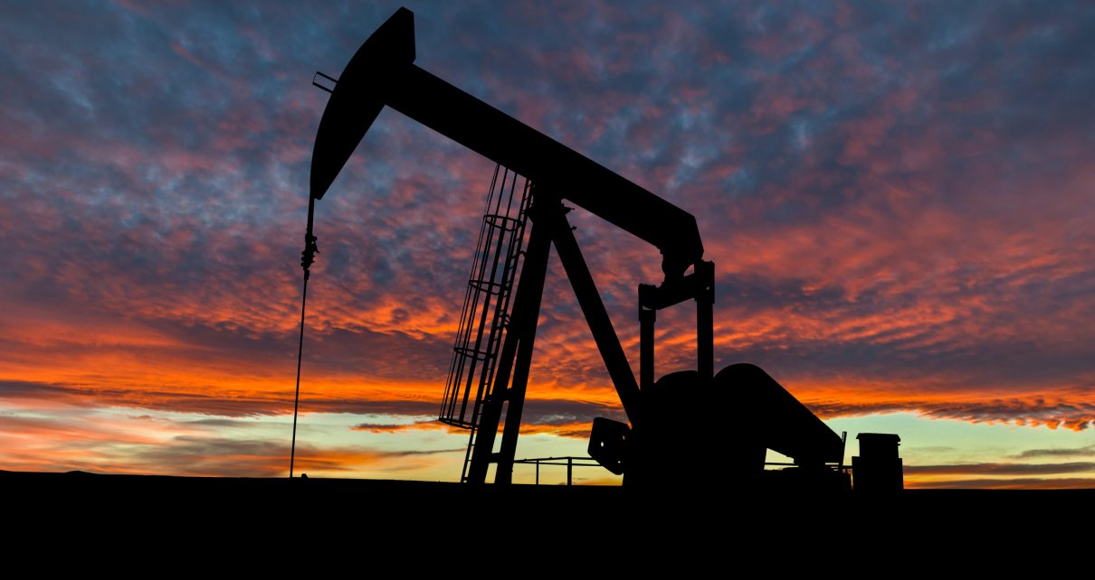
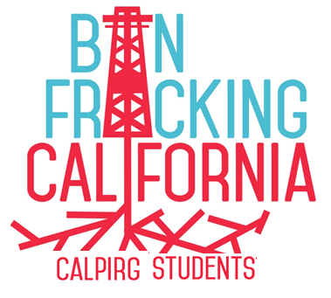

Oil and Gas wells in California
Notes:
Slide 1: (Handri)
When we talk about Ending Oil Drilling or even banning fracking, we often relate it to climate change. Climate Change in terms of the race to zero carbon emissions and cool new solar or wind technology or policy, but in this campaign we want to broaden the scope of conflict and talk about race, class and social structures.
Environmental racism is real and the strides to racial and environmental justice are often glanced over or thought of as the forgotten secondary goal. In the transition to a 100% renewable future, in the transition to a Zero Carbon society we have to be aware of how we get there and not just the end goal of 100%.

Slide 2
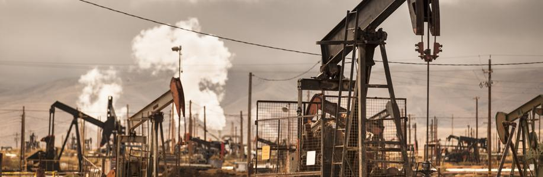
Hazards to Surroundings
Air pollution
Central nervous system damage, birth defects, cancer, or premature death.
Contamination of drinking water and soils
Over 233 cancer causing chemicals in the water
Seismic risks
1,500 Earthquakes over a 5-year period not known for earthquakes but known for Fracking
Noise and light pollution
Public safety
Notes:
Slide 2: (Max)
For the people who live close to oil and gas wells, they face dangerous and disproportionate hazards in their life.
We all saw in the documentary that there were many risks and effects to the frontline communities. I’ve listed a few on this slide so we’re on the same page. There are air pollution, contamination of drinking water, noise and light pollution, and potential risk in seismic activity and public safety.
For example, research has linked pollution from fracking to unhealthy levels of smog and toxic air contaminants. Exposure to this pollution can cause eye, nose, and throat irritation, respiratory illnesses, central nervous system damage, birth defects, cancer, or premature death.
The hydraulic fracturing process poses multiple threats to water supplies... A significant portion of the fracking fluid returns to the surface, where it can spill or be dumped into rivers and streams. Underground water supplies such as aquifers can also be contaminated by fracking, through migration of gas and frack fluid underground. Through the efforts of Activist scientist, we have found over 233 cancer causing chemicals in the water - And that includes only the ones we know about!
A seismology study in LA found 1,500 Earthquakes over a 5 year period in a part of the county not known for earthquakes but known for Fracking
All this is to say that oil and gas drilling is dangerous. And Fracking is the worst out of all the forms.

Slide 3
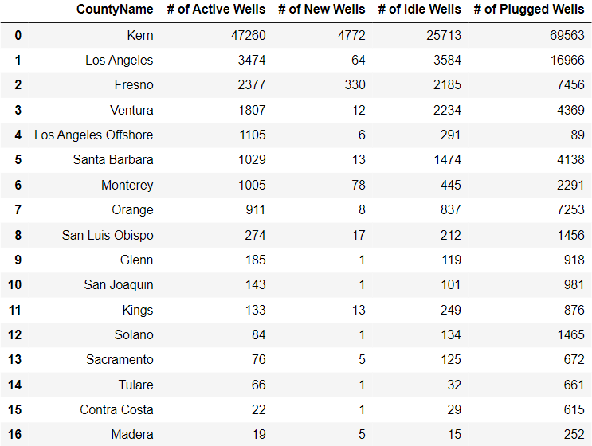
How many ?
Today, there are still 60,638 active wells, 5,345 new wells, 38,704 Idle wells, 126,646 plugged wells in California.
Notes:
Slide 3: (Max)
So How many of these dangerous oil and gas wells are we facing?
To put it in direct terms, today we have 60,000 active wells, 5,000 new wells, 38,000 idle wells and 126,000 plugged wells. Active wells are drilling sites which are currently pumping out oil, New wells are drilling sites which have just been built but are also active, idle wells means they could be drilling but are actually just left sitting there. Plugged wells are older drilling sites which have a concrete plug thrown straight on top of it - they still pose serious environmental and health threats and are often not cleaned up but left as it.
The table on the right-hand side, ranks the top counties that have the most active wells.
We can see that Kern county is ranked at the top having 47,000 active wells. Followed by Los Angeles county, which is one of the most densely populated regions in California with 3,500 active wells. Santa Barbara county is on there too, taking the number 5 spot with just over 1000 active wells.
On the next few slides we’ll go over intersectionality and how it affects the most vulnerable groups - low-income and minority populations.

Slide 4
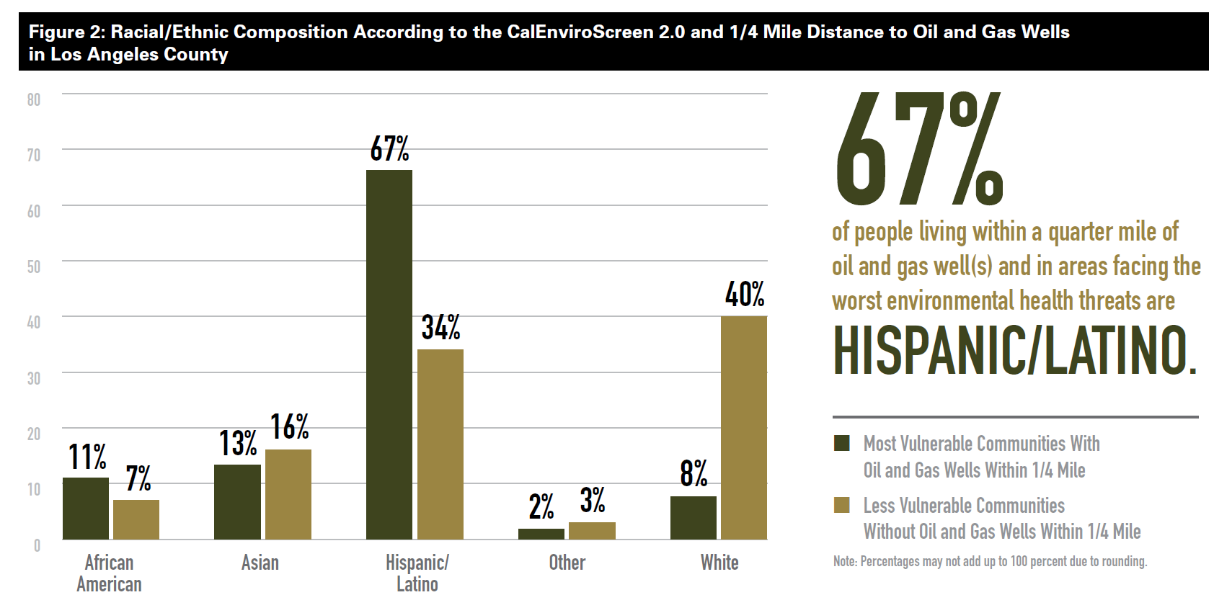
Who are being affected?
1 mile = 5.4 million Californians. 14% of the state’s population
Within one mile of an oil or gas well, 69 % are people of color.
Notes:
Slide 4: (Handri)
California’s communities of color have long been dumping grounds for industrial pollution.
An NRDC report reveals that 14 percent of the state’s population—5.4 million Californians—already lives within a mile of at least one oil or gas well. Of that group, 69 percent—3.7 million residents—are people of color.
Additionally, one-third of people who live within a mile of a well—1.8 million people—live in communities that already shoulder a disproportionate amount of the state’s air, water and soil pollution as a result of living close to industrial facilities, transportation corridors, hazardous waste facilities and toxic clean-up sites. Nearly 92 percent of those residents are people of color.
The graph on the right shows the demographic breakdown within a quarter mile of oil and gas sites in Los Angeles county. The graph also specifies communities already shouldering the disproportionate environmental harms and labeled as “vulnerable” in the dark green and labeled as less vulnerable in the brown.

Slide 5
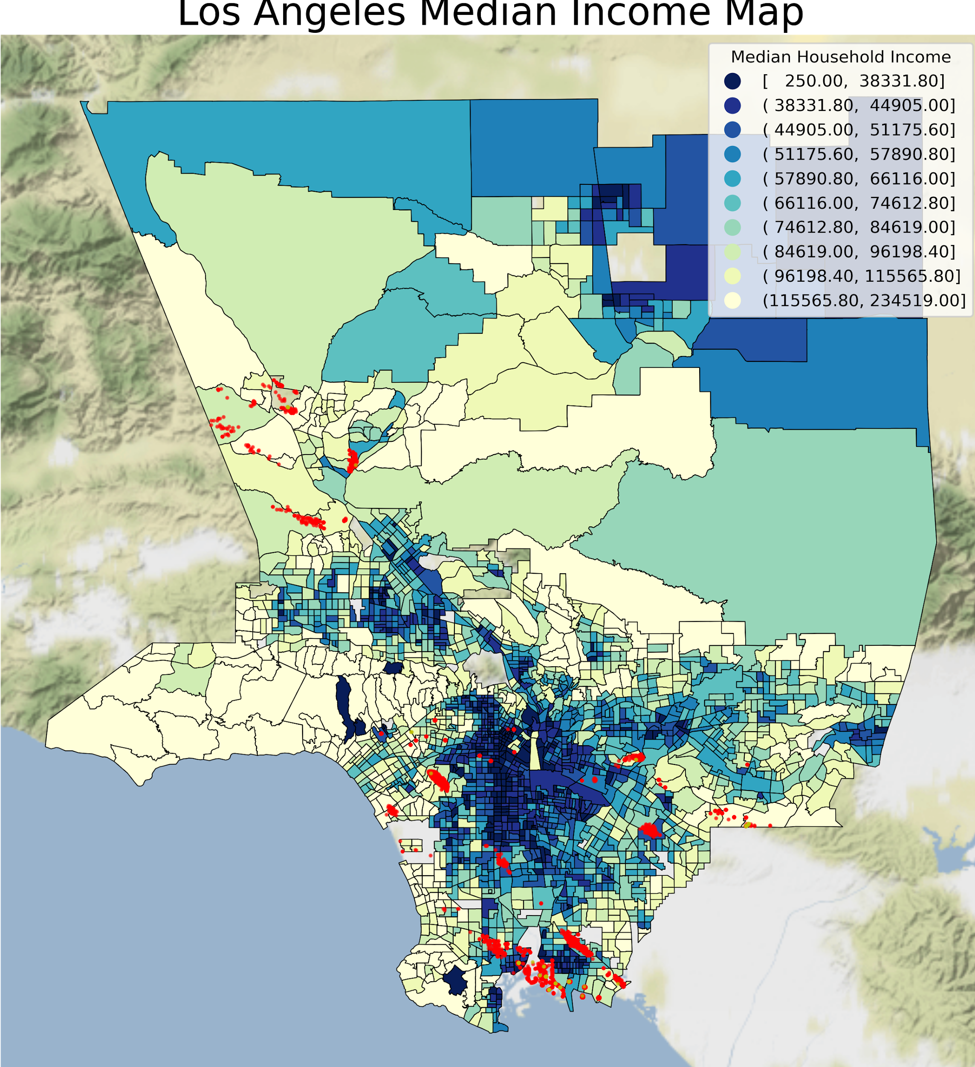
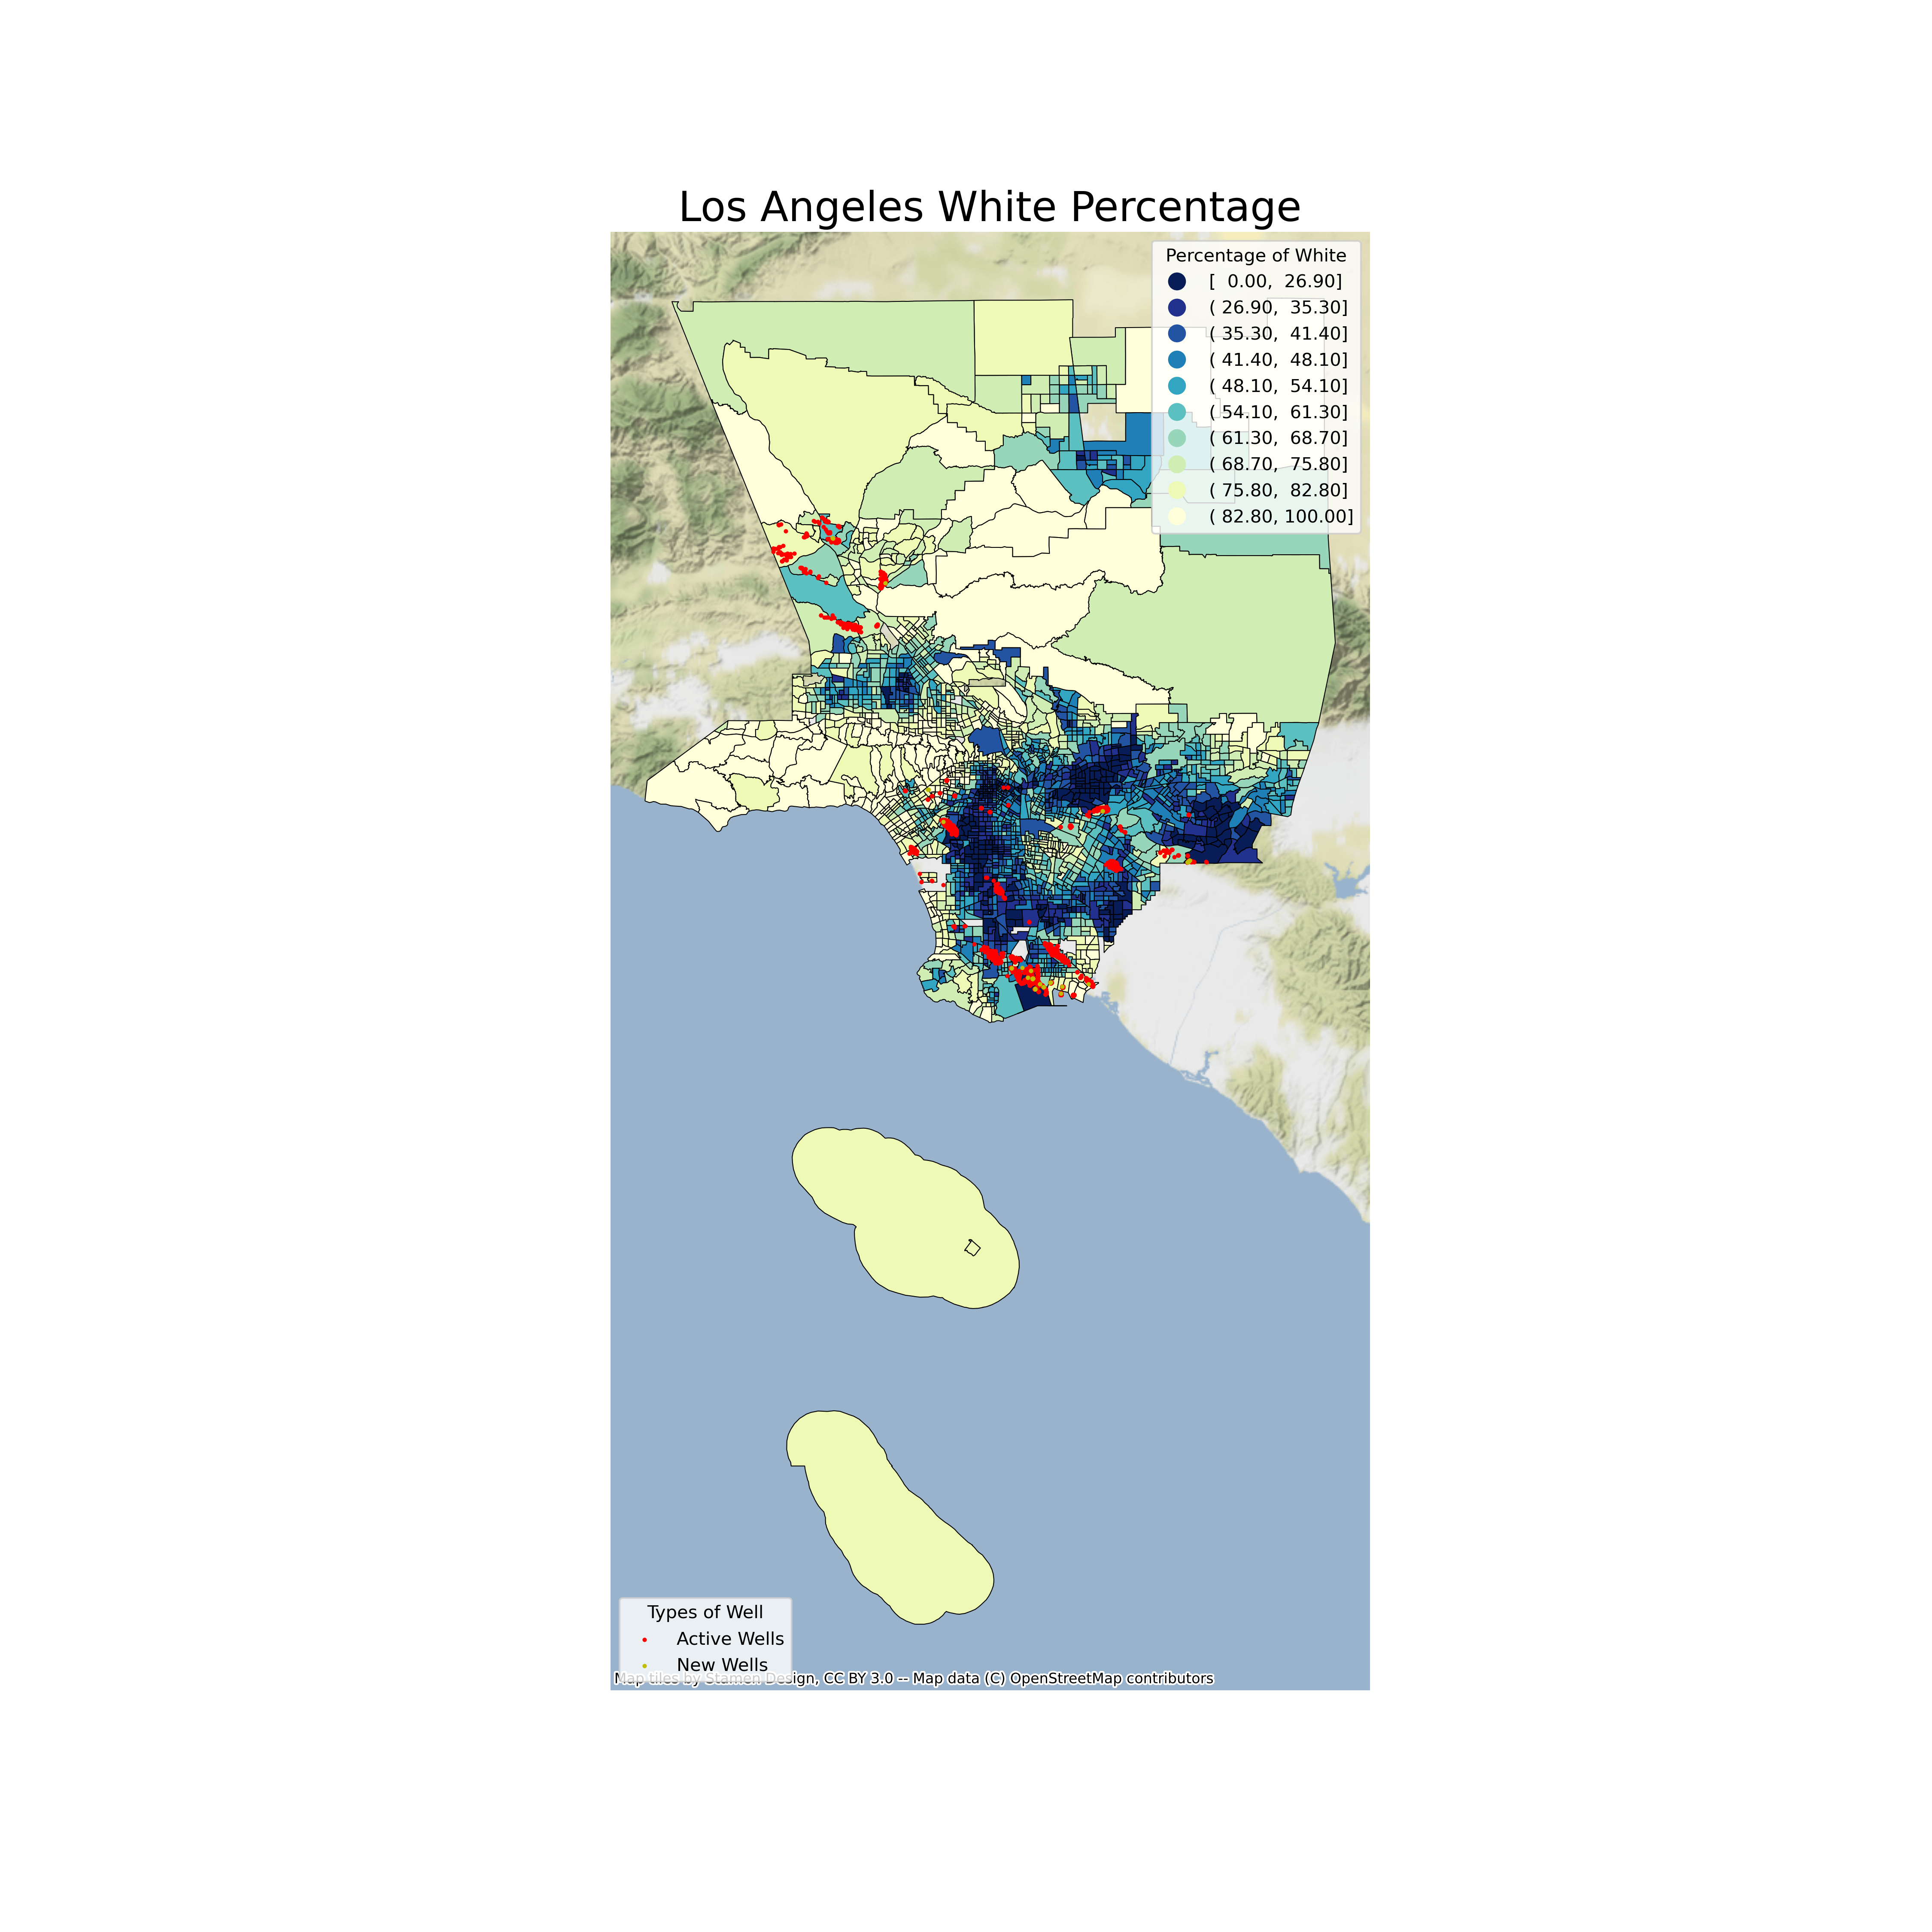
L.A. - Economic Vulnerability and Oil and Gas Drilling
the darker blue regions represent the economically vulnerable
-The darker blue the color, the more economical vulnerable.
- Red Dots = Active wells,
- Yellow Dots = New wells
- Correlation between low household median income and drilling sites
Notes:
Slide 5: (Max)
This slide contains an image of Los Angeles county plotted by the Economic vulnerability. Economic vulnerability in this case is measured as median household income from the 2019 census tracts. The darker blue regions represent the economically vulnerable and the white area represents high income neighborhoods. The coloured dots are where the oil and gas drilling sites are located. Red in this case is Active wells and yellow is the newly constructed wells. The drilling site data was taken from real-time data on CALGEM’s website about 3 weeks ago. CALGEM is the state’s regulatory oil and gas agency which is the actual agency that gives out fracking and oil and gas drilling permits.
First of all, we can see that oil and gas wells are built in areas which are very densely populated! The next thing we see is a pattern of correlation between the low-income with the oil and gas drilling site distribution. If we draw circles around areas with high drilling density we noticed the color enclosed is mostly dark blue, suggesting that the people who live around the drilling sites are more economically vulnerable.
I’ve drawn circles around the areas with high drilling site concentration. If we look at the bottom of the map we can see that there are a few circles. That area is Lakewood which has a median income of 38,000 dollars or less per household. We also know that Lakewood is around 60% minorities.
Other circles are shown also to be in low income communities.

Slide 6
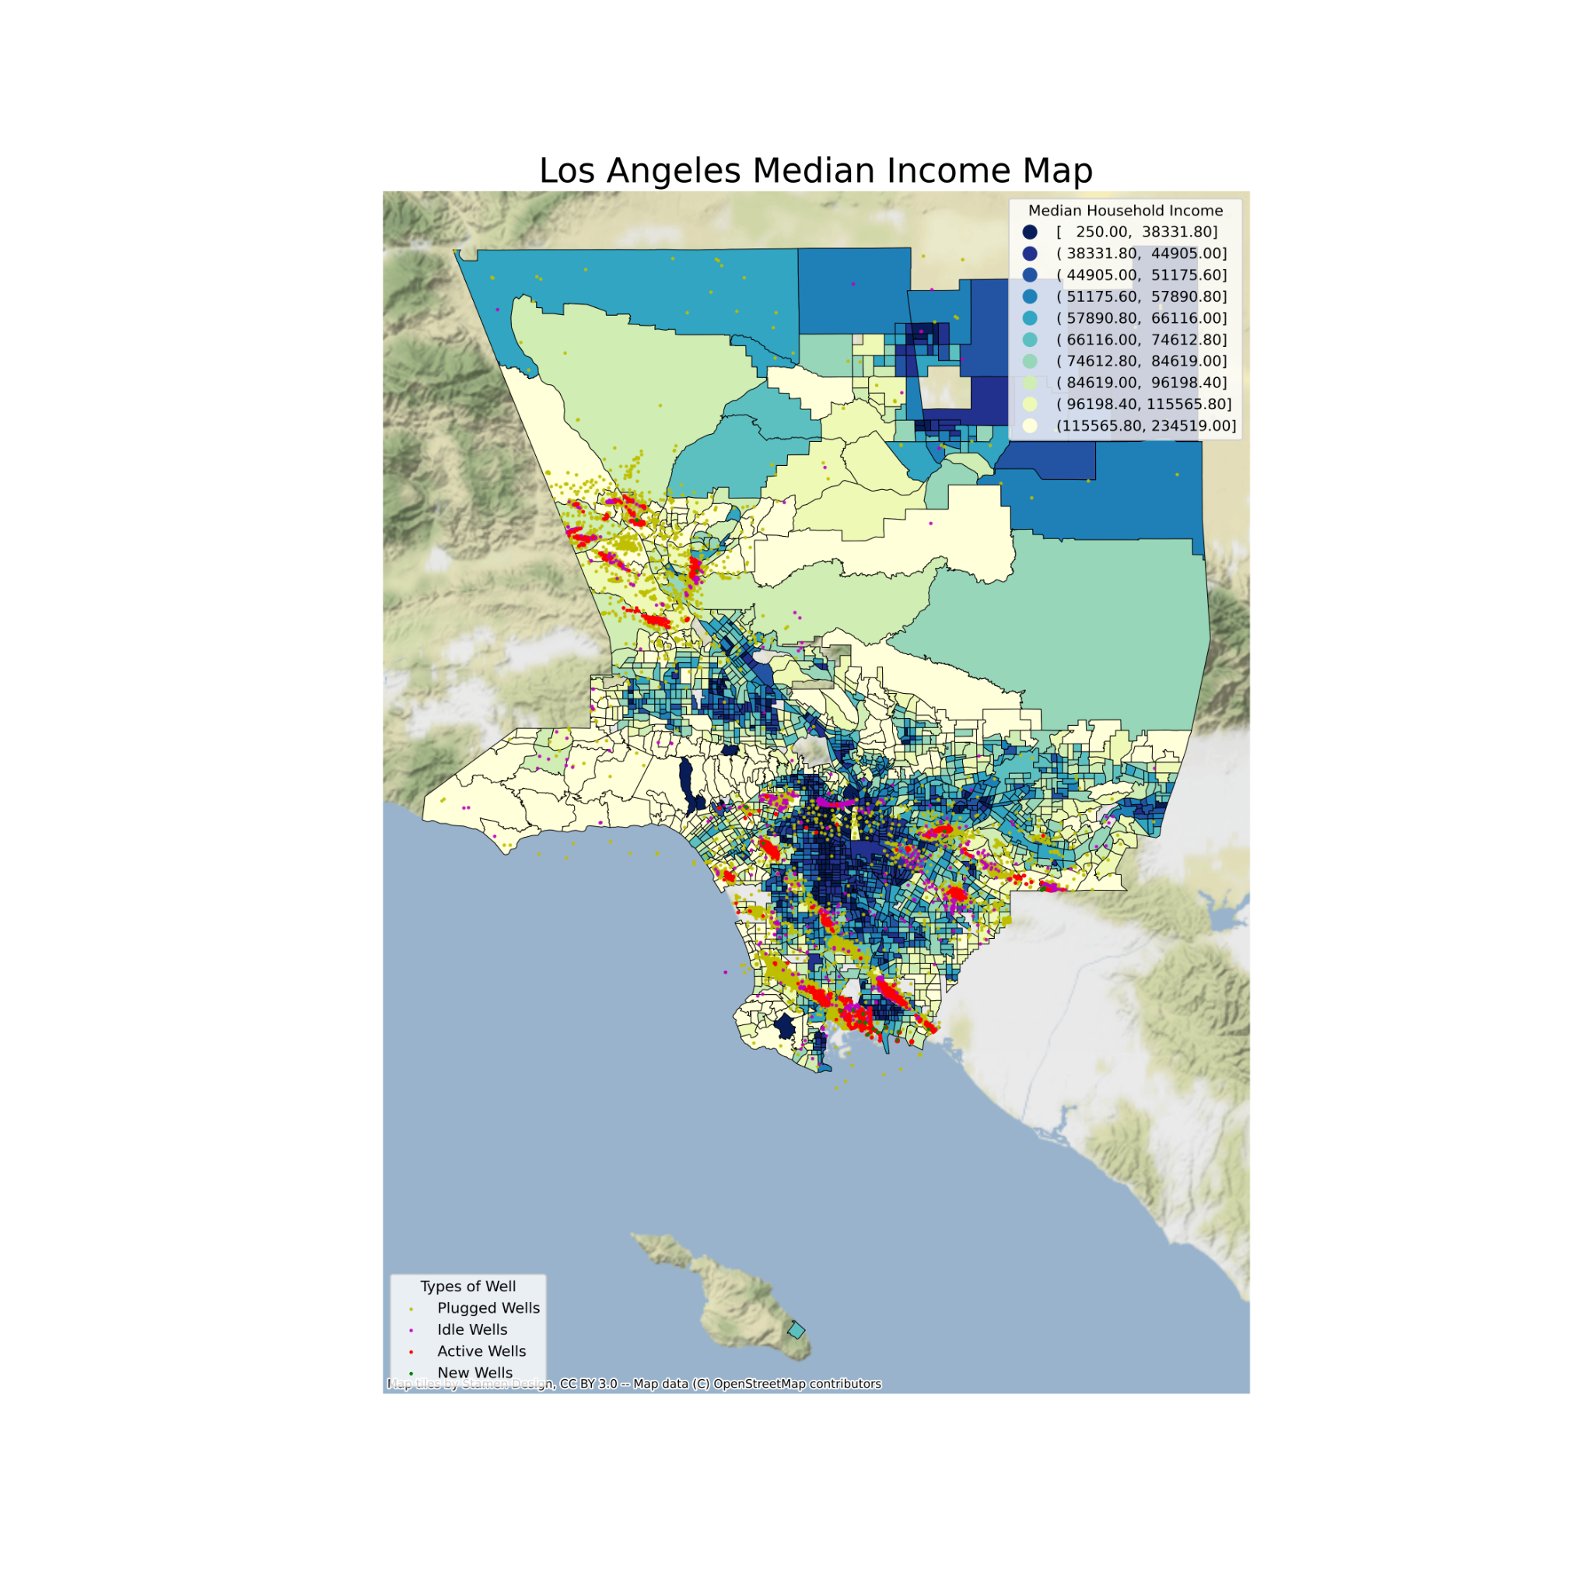
L.A. - Economic Vulnerability and Oil and Gas Drilling
- This is same as the previous map but it includes Active, New, Idle and plugged wells.
- Red Dots = Active wells
- Green Dots = New well
- Yellow Dots = Plugged
- Purple Dots = Idle
Notes:
Slide 6: (Max)
Here we have the same map but I wanted to include four types of wells: Active, New, Idle and Plugged.
Although idle and plugged wells may sound harmless. These drilling sites are still very harmful to the environment and frontline community health. These additional drilling sites still pose a dramatic threat.
As you can see oil and gas drilling is an issue about economic class but it also just generally affects a lot of people.

Slide 7
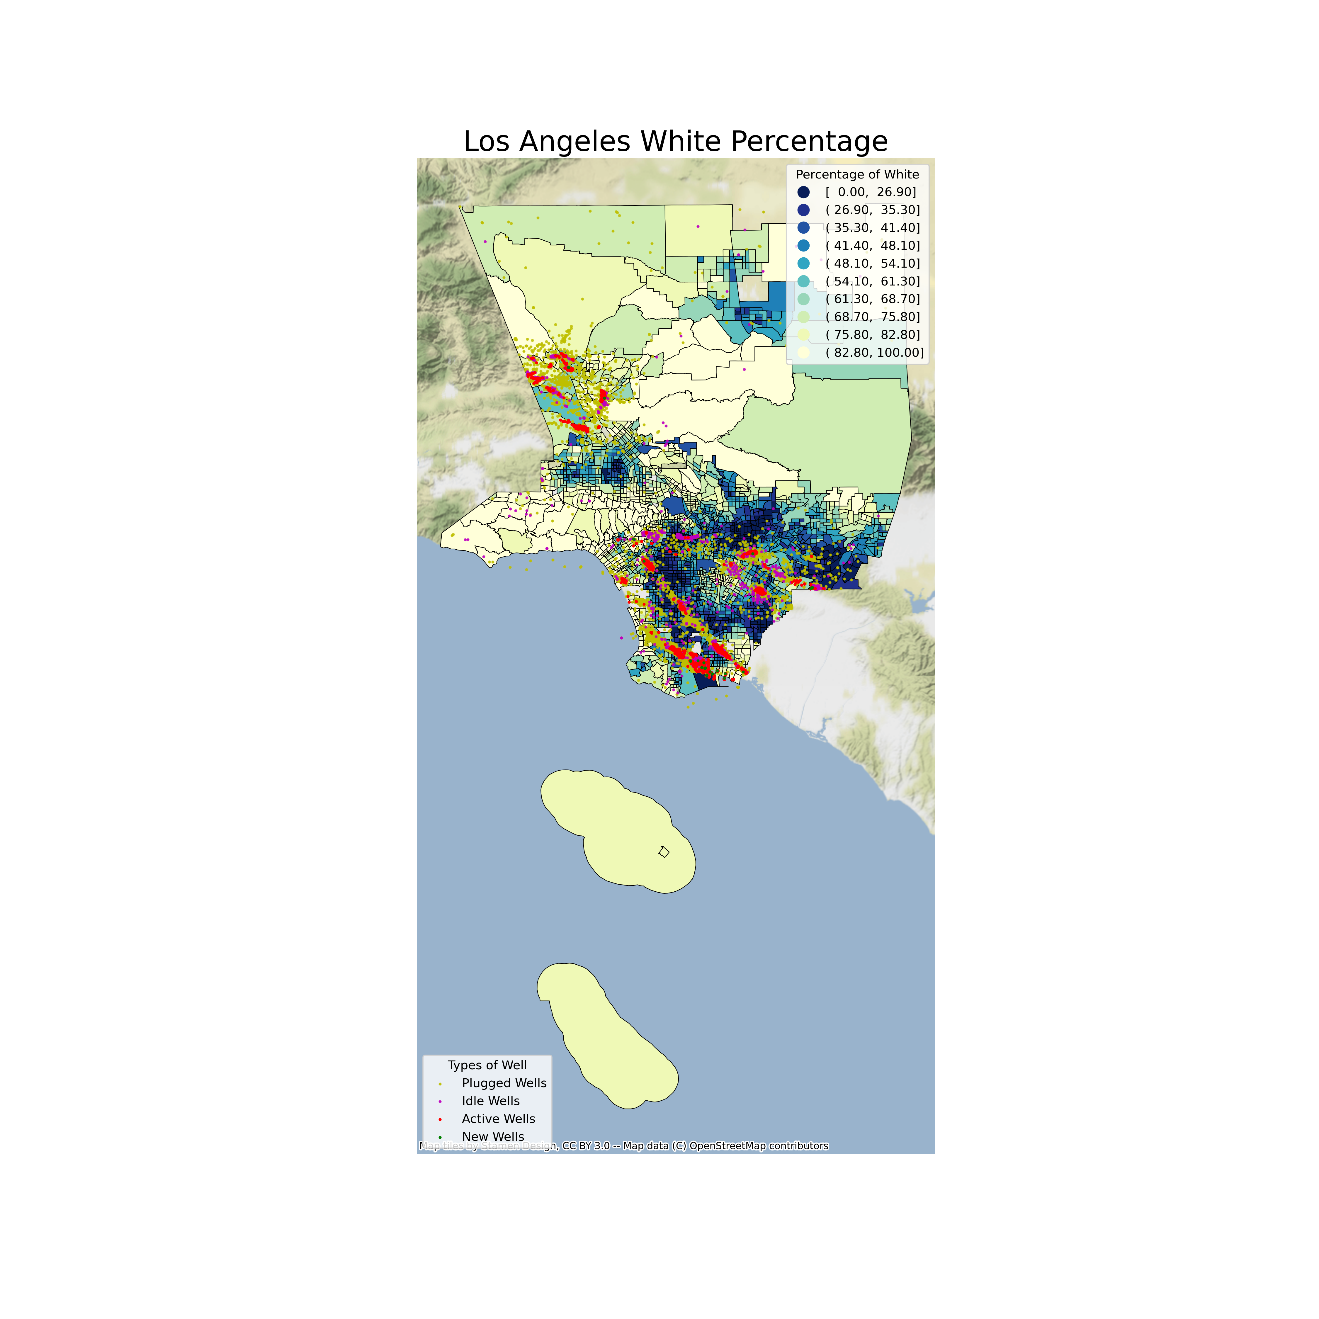
L.A. - Ethnicity and Oil and Gas wells
the darker blue regions represent the economically vulnerable
Notes:
Slide 7: (Max)
Taking a look at our last two maps. These map shows the distribution of the minority populations with the location of the oil and gas drilling sites. The minority data is actually mapped from percentage white on the 2019 census tract. The drilling sites is from the same CALGEM data as well. The two maps shows the difference when idle and plugged wells are included.
In the US, racial minorities and income is closely tied and we can see here that race and oil drilling has a strong correlation.

Slide 8
Sources
Now take a look at your County!
https://www.nrdc.org/media/2014/141022
https://maps.conservation.ca.gov/oilgas/
https://www.census.gov/
https://drive.google.com/drive/folders/1hWEWJWHoTThoUTxZZ9bQ0v3mJsrEAPZN?usp=sharing

